Slide 1

Student Performance Analyzer
Analyzing student performance using Python and machine learning.
This presentation showcases a Streamlit application designed to
analyze student grades, predict success, and inform teaching strategies.

Slide 2


Project Overview and Objectives
Goal
Objectives
Importance
Develop a tool to analyze and predict student success.
Use ML for performance analysis.
Enable data-driven education assessment and decision-making.
Create interactive Streamlit app.
Provide insights on success factors.

Slide 3
Dataset Description
Source
Preprocessing
Student performance dataset with detailed records.
Data cleaning to handle missing values and ensure accuracy.
Features
Normalization and formatting for model training.
Student ID, Name
Marks in Maths, Physics, Chemistry
English and Computer Science scores

Slide 4
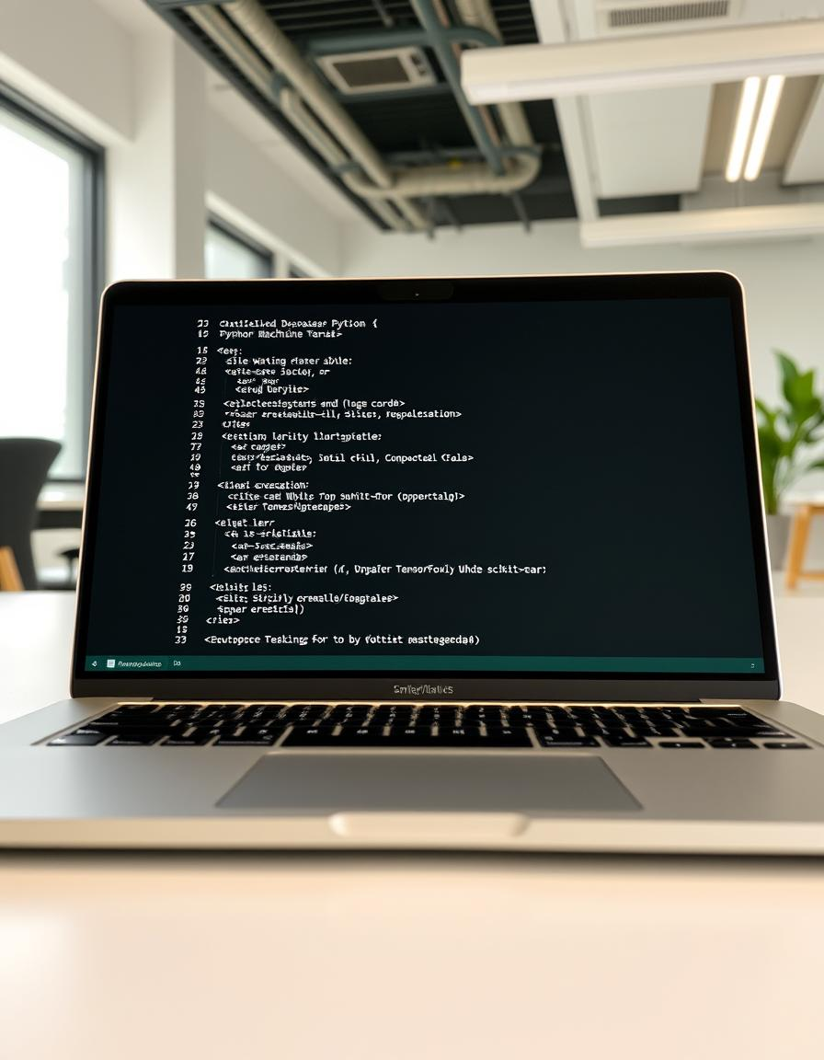
Machine Learning Approach
Libraries Used
scikit-learn, pandas, numpy for data processing and modeling.
Algorithms Explored
Linear Regression, Decision Trees evaluated.
Chosen Model
Model selected based on accuracy and interpretability.
Model Training
Data split and validation performed for robust learning.

Slide 5
Model Training and Evaluation
Data Split
Results
80% training, 20% testing for balanced evaluation.
Metrics exceeded benchmarks indicating strong model fit.
Performance Metrics
Optimization
Accuracy
Precision
Hyperparameter tuning improved model effectiveness.
Recall
F1-Score

Slide 6
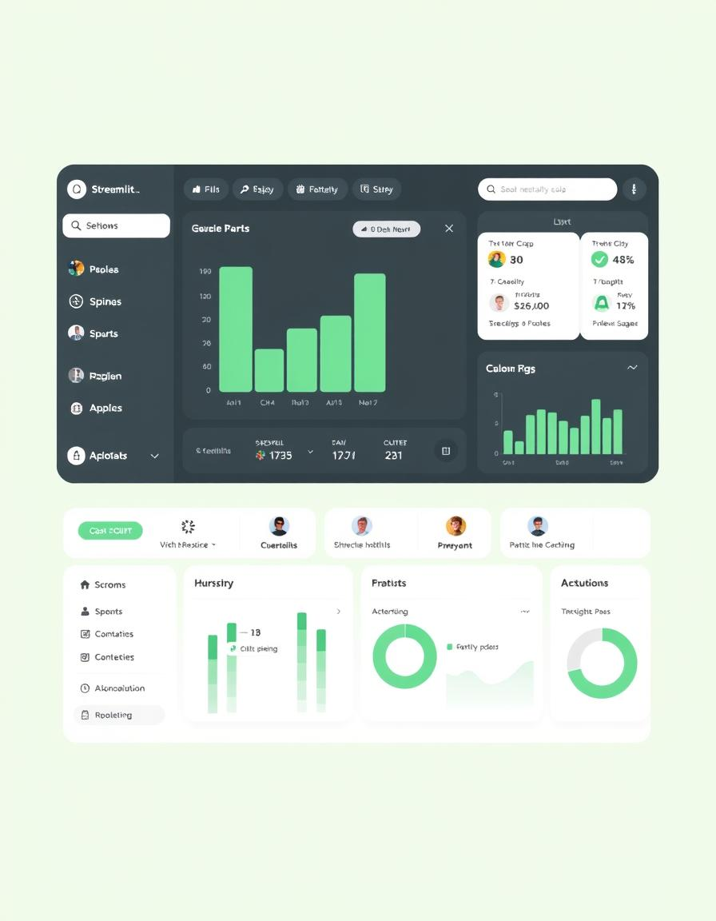
Streamlit Application Development
Streamlit Framework
User Interface
Enables rapid, interactive data app development in Python.
Clean design with input fields and action buttons.
Interactivity
Users enter marks, triggering instant performance analysis.

Slide 7
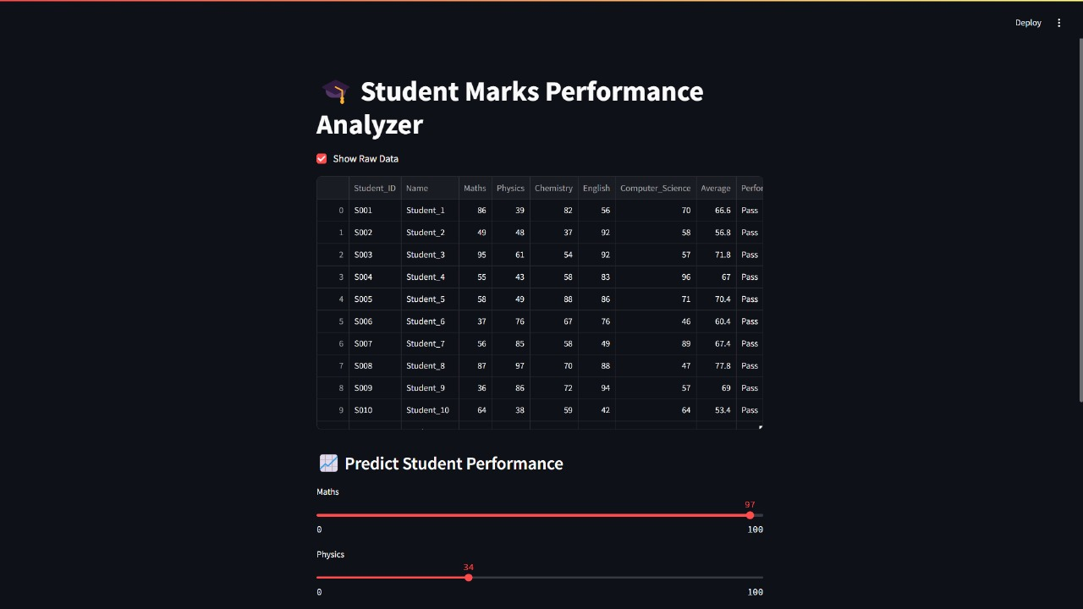
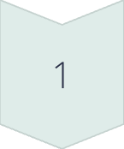
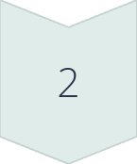
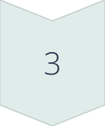
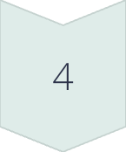
Streamlit App: User Interface and Workflow
Input Details
Set student name and marks for each subject.
Calculate Average
App computes average score automatically.
Pass/Fail Display
Status shown based on average compared to cutoff.
Visualizations
Charts and graphs illustrate subject-wise performance.

Slide 8
App Functionality and Features
Average Calculation
Pass/Fail Threshold
Visual Insights
The application calculates the average score by summing the marks obtained in all subjects and dividing by the total number of subjects.
Students scoring 40% or higher pass.
Subject-wise bar charts
Overall performance trends

Slide 9
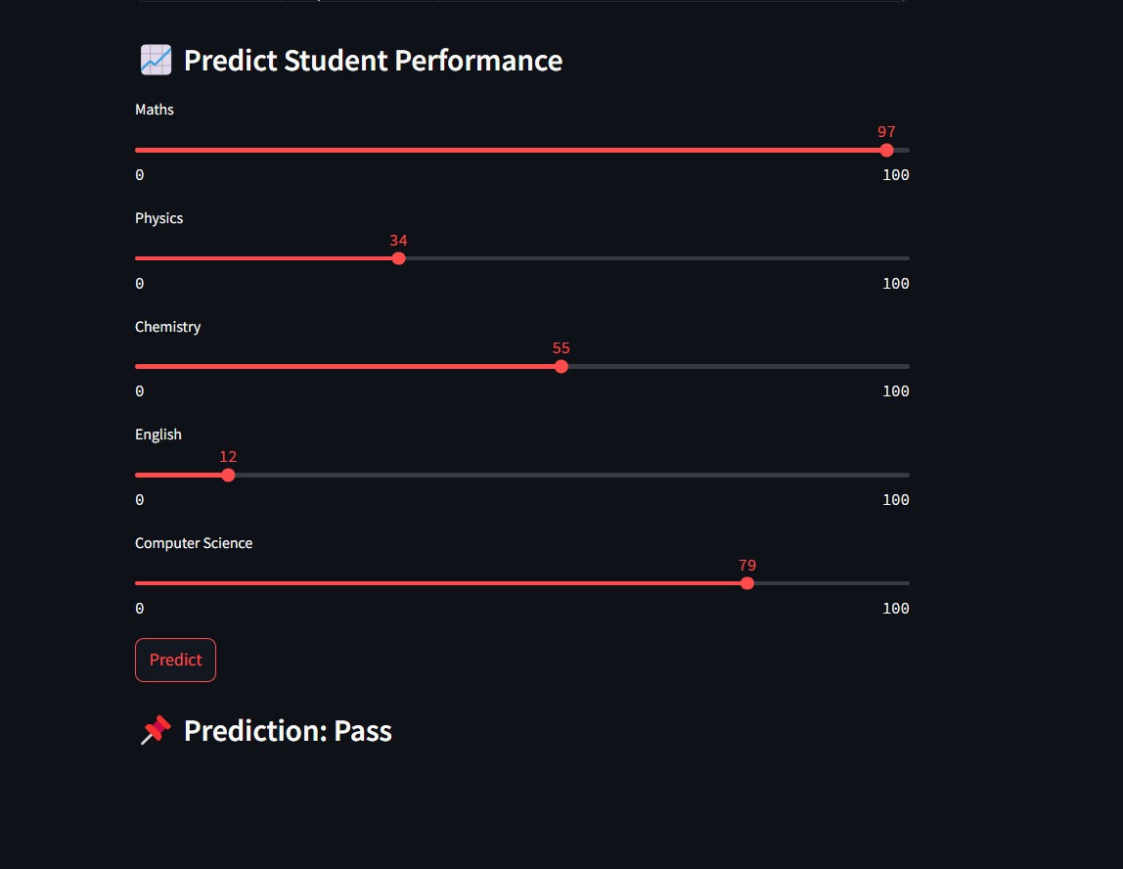
Results and Insights
Key Findings
Influencing Factors
Identified subjects influencing overall success most.
Consistent study habits and subject strengths impact results.
Use Cases
Supports educators in tailored interventions and feedback.

Slide 10

Conclusion and Future Work
Next Steps
Future Improvements
Engage stakeholders for deployment and feedback.
Project Summary
Advanced machine learning models
Effective ML-based tool for student performance analysis developed.
Personalized student recommendations
Broader datasets with demographics

